Slide 1

Predicting Customer Behaviour using Neural Netwoek

Slide 2
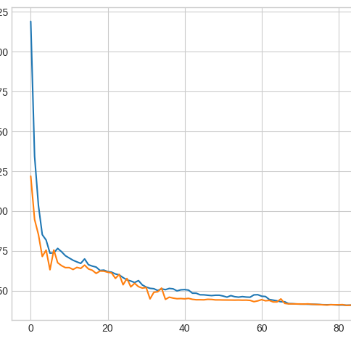
VISUALIZATION
Upon creating neural network,
The validation loss is 0.4.
The train loss is 0.4
The accuracy we achieved is 85%

